Slide 1

Process Mining Virtual Internship
by
S. PREETHI
Roll No. 224G1A3271
Department of Computer Science and Engineering (Data Science)
Srinivasa Ramanujan Institute of Technology
(Affiliated to JNTUA & Approved by AICTE) (Accredited by NAAC with ‘A’ Grade & Accredited by NBA (EEE, ECE & CSE)
Rotarypuram Village, B K Samudram Mandal, Ananthapuramu – 515701.
2024 - 2025

Slide 2



Contents
Process Mining Virtual Internship
Course Objective
Introduction
Technology
Applications
Modules
Real Time applications
Learning outcomes
GitHub Link
Queries
224G1A3271

Slide 3
Course Objective
Process Mining Virtual Internship
The goal of process mining is to improve the performance of business and make data-driven
decisions
The idea of process mining is to discover, monitor and improve real processes by extracting knowledge from data readily available in an organization’s information systems.
The objectives of the Process Mining Virtual Internship are to equip participants with a comprehensive understanding of process mining concepts and methodologies
The main objectives of a process mining course could include:
Understanding Process Mining Concepts: Understanding fundamental concepts of process mining, such as event logs, process models, process discovery, conformance checking.
224G1A3271

Slide 4
Introduction
Process Mining Virtual Internship
What is Process Mining:
Process mining is a data-driven methodology that involves analyzing event logs from various information systems to discover, monitor, and improve business processes. It aims to provide insights into how processes are actually executed, rather than how they are supposed to be executed according to predefined models or guidelines.
Process mining holds significant importance for organizations across various industries due to its ability to provide valuable insights and drive operational improvements.
Process Mining is often described as occupying the area between business process management and data mining.
224G1A3271

Slide 5
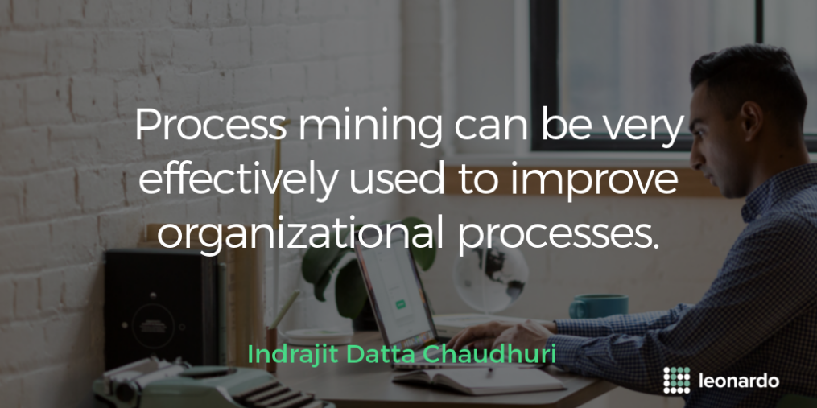
Contd….
Process Mining Virtual Internship
The main components of Process Mining:
Understanding Data Sources : how to collect, preprocess, and transform event data from various sources such as information systems, logs, and databases into suitable formats for analysis
Process Discovery : Introduce techniques for automatically discovering process models from event data, including algorithms like Alpha Miner, Heuristic Miner, and Inductive Miner.
224G1A3271

Slide 6
Contd….
Process Mining Virtual Internship
Enhancing Process Models : Cover techniques to improve the accuracy and comprehensibility of process models by incorporating additional information or domain knowledge.
Process Analysis and Visualization : Providing knowledge about techniques for visualizing process data, analyzing process performance, and deriving insights from process metrics.
It is important because the reality of the problem is sometimes bigger to understand to extract an exact solution, in such situations this technology helps in making the concept into the reality
224G1A3271

Slide 7
Contd…
Process Mining Virtual Internship
Benefits of Process Mining:
Improve performance management
Eliminate unnecessary steps
Reduce reaction time
Identify and resolve process bottlenecks
Resolve inter-process conflicts
Analyze audit data faster
224G1A3271

Slide 8
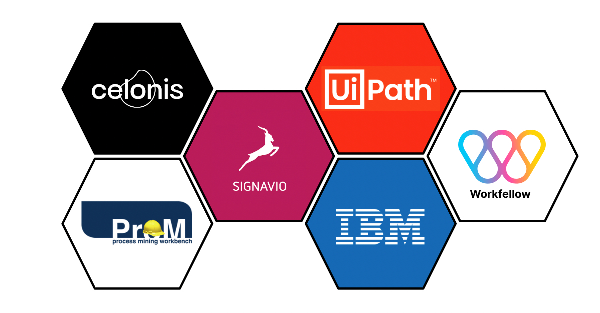
Technology
Process Mining Virtual Internship
Process Discovery Tools:
Disco: A popular process mining tool that offers process discovery, conformance checking, and performance analysis capabilities
224G1A3271

Slide 9
Contd…
PROM : An open-source framework that provides a wide range of process mining plugins, including various process discovery algorithms
Celonis : Offers a process mining platform with advanced AI capabilities for discovering, monitoring, and improving processes
Predictive Process Monitoring Tools : These tools use historical process data to predict future process behavior, allowing for proactive interventions
Data mining: Data mining is the process of extracting knowledge from data. In the context of process mining, data mining is used to identify patterns and trends in event data

Slide 10
Contd…
Process Mining Virtual Internship
Machine learning : In the context of process mining, machine learning is used to build models that can predict future behavior of processes
Process modeling : Process modeling is the process of representing a process in a graphical or textual form. In the context of process mining, process modeling is used to create a graphical representation of the actual process
224G1A3271

Slide 11
Applications
Process Mining Virtual Internship
Performance Analysis : Process mining allows organizations to monitor process performance and identify areas for improvement
Visualization and Reporting : Provide visual representations of process models and performance metrics for better communication
Process Mining and Supply chain : Process mining offers a lot of optimization opportunities to the complex work.
Procure to pay, order to cash , production process , account payable/account receivable management
224G1A3271

Slide 12
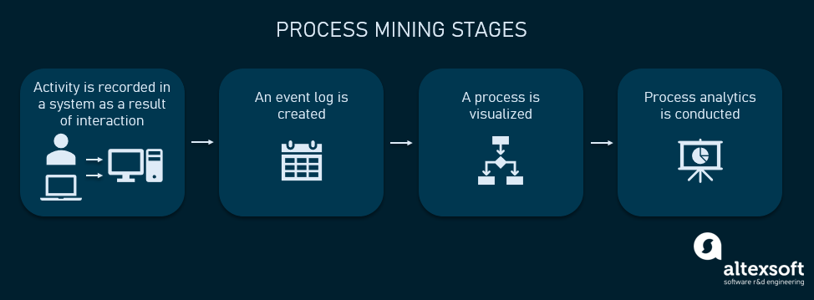
Modules
Process Mining Virtual Internship
Stages in Process Mining :
224G1A3271

Slide 13
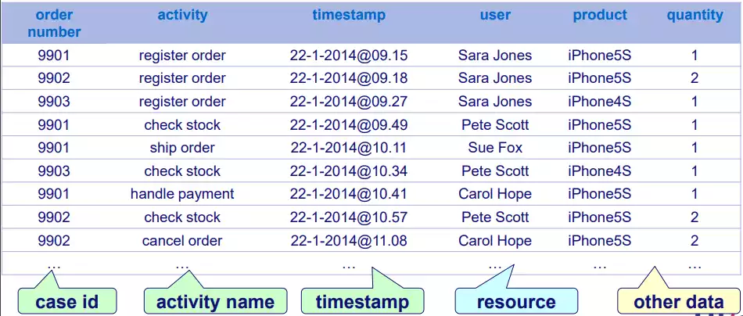
Modules
Process Mining Virtual Internship
1.The activity or interaction with the system takes place, creating a digital record. Some examples of such activities are receiving an order, submitting a piece of documentation, approving a loan, entering information into a health record, etc.
A sample event log of order handling
224G1A3271

Slide 14
Modules
Process Mining Virtual Internship
3. The visualization of a process is automatically created using event logs.
4. Process analytics takes place. Here, KPIs can be created and monitored to uncover potential improvement areas; data mining and/or ML algorithms can be used to detect hidden patterns and dependencies
224G1A3271

Slide 15
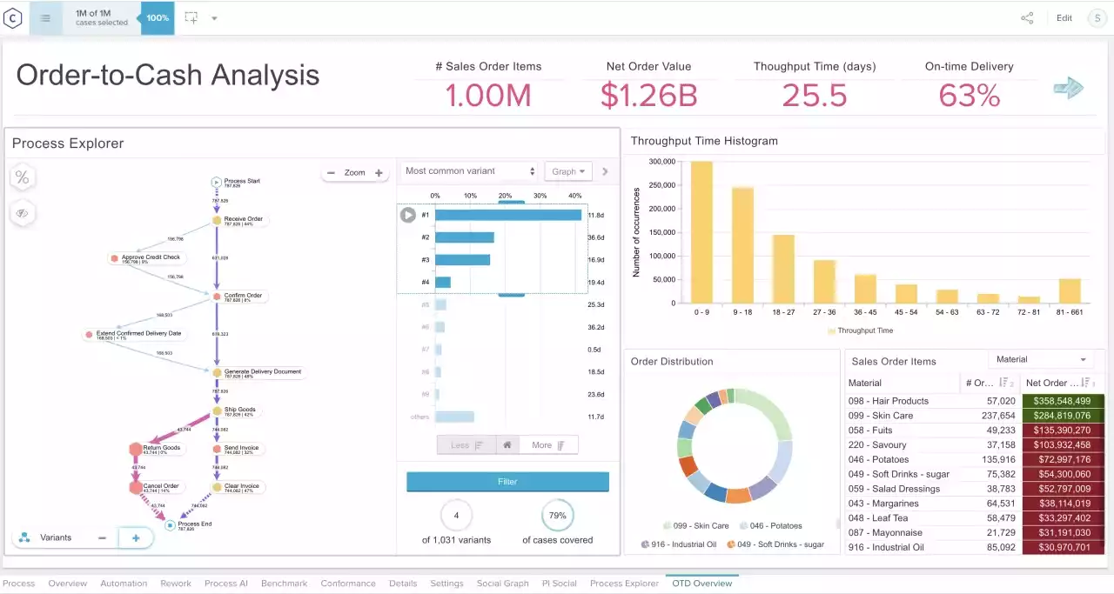
Modules
Process Mining Virtual Internship
Process visualization and analytics
224G1A3271

Slide 16

Real Time Applications
Process Mining Virtual Internship
What is process mining in healthcare :
Process mining in healthcare is the application of process mining technology to clinical processes. It determines where and how to implement a quality improvement strategy that corresponds to the healthcare needs.
Process mining enables healthcare professionals to understand and analyze these processes in order to optimize the overall process efficiency.
224G1A3271

Slide 17
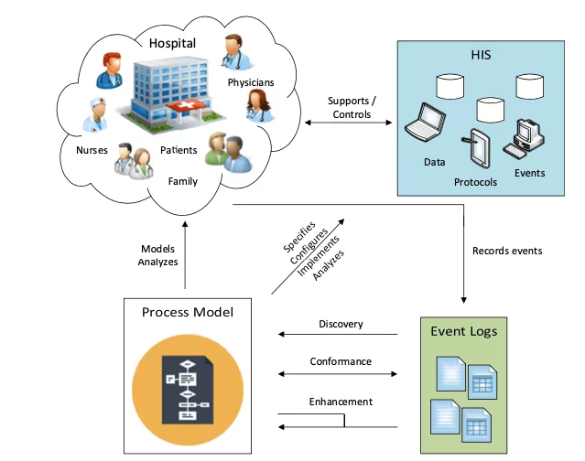
Real Time Applications
Process Mining Virtual Internship
How is process mining used in healthcare :
Process mining is used in healthcare for the analysis of Hospital Information Systems (HIS) These systems store data for all interactions among units helping patients.
224G1A3271

Slide 18
Learning Outcomes
Process Mining Virtual Internship
Gain an understanding of basic process mining concepts
Understand what process mining is and the basics of how it works.
Gaining experience in analyzing and optimizing business processes
Learning about Real world Applications of Process Mining
224G1A3271

Slide 19
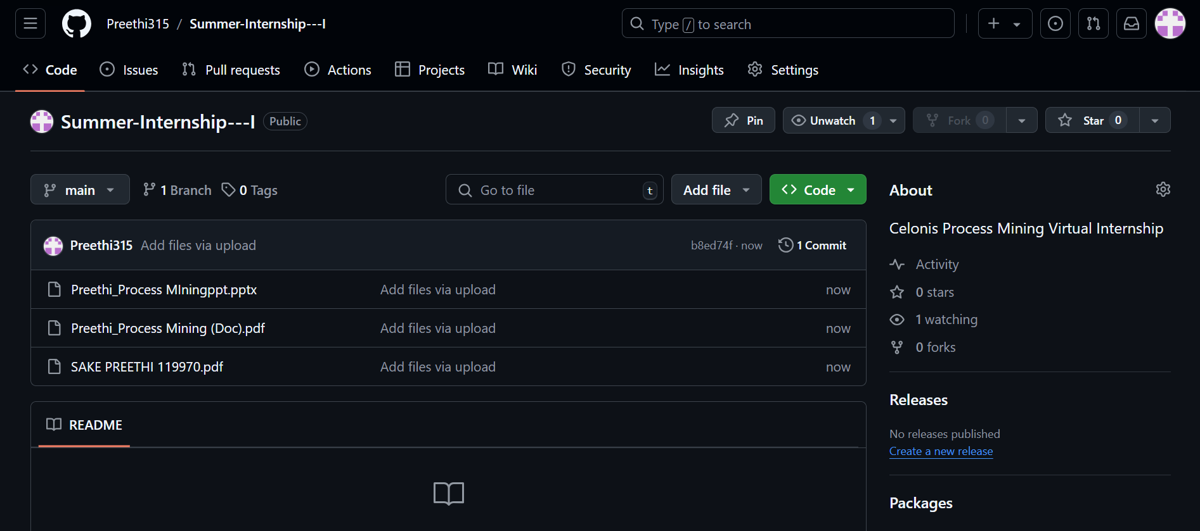
Git Hub Dashboard
Process Mining Virtual Internship
Repository Name : Summer Internship - I
Git Hub Link: https://github.com/Preethi315
224G1A3271

Slide 20
Process Mining Virtual Internship
Any Queries?
224G1A3271

Slide 21
Process Mining Virtual Internship
Thank You!!!
224G1A3271

